Slide 1
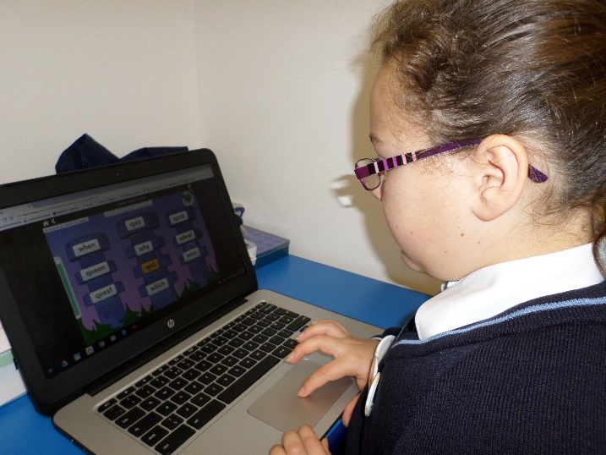
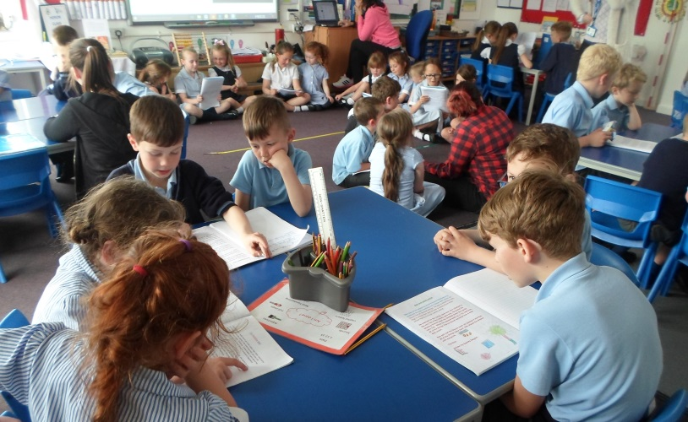
Welcome to Our Lady’s School
SEN INFORMATION REPORT

Slide 2
What is Our Lady’s School like?
How does Our Lady’s know how effective its provision for SEN is?
How does Our Lady’s know if a child needs extra help?
NEXT PAGE
Who should I contact at Our Lady’s?
What should I do if I think my child has special educational needs?
How does Our Lady’s know how well my child is doing?
What would you like to know?
How will I know how well my child is doing?
What are the different types of support available at Our Lady’s?
How will the curriculum and learning environment be adapted to meet my child’s needs?
How will Our Lady’s help me support my child?
How will Our Lady’s ensure that my child is included in all aspects of school life?
How will Our Lady’s decide what, and how much, extra support my child needs?
Who will support my child at Our Lady’s?
Find out more

Slide 3
What is Our Lady’s School like?
Our Lady’s School is a mainstream primary academy trust school, within the Plymouth Diocese Catholic and Anglican Schools’ Trust (CAST). There are 208 pupils on roll in single year-group classes.
At Our Lady’s we aim to provide a Christian, caring, secure family environment where each child is valued as an unique individual who is able to benefit from and contribute to the life of the school.
We value the trust placed in us by parents of the children in our care and we strive to ensure that all our children prosper and thrive. The environment we create is one where the children feel confident, secure, valued and able to express their views and opinions whilst understanding the importance of listening to others.
We are currently engaged in the Devon Dyslexia Award and work hard to ensure that all children’s literacy needs are identified and fully
supported.
NEXT PAGE

Slide 4
Who should I contact at Our Lady’s?
The Special Needs Co-ordinator (Senco) is Eve Daunton.
She can be contacted via the school office 01271 345164 or by email senco@olcs.uk
The governor responsible for Special Educational Needs (SEN) is Geraldine Herage.
She can be contacted via email gherage@olcs.uk or via the school office.
NEXT PAGE

Slide 5
How does Our Lady’s know if a child needs extra help?
At Our Lady’s, we may notice that a child is not making progress or has a significantly greater difficulty in learning than the majority of their peers.
Concerns may be raised by staff about difficulties with social interactions or communication.
Parents may tell us of concerns or difficulties.
At Our Lady’s, provision is discussed between class teachers, the Principal and SENCO at regular progress meetings. This ensures we identify children who may need extra provision, monitoring their progress carefully.
NEXT PAGE

Slide 6
What should I do if I think my child has special educational needs?
Please talk to us.
Firstly, talk to your child’s class teacher. They know your child best and can talk to you about learning and progress.
If further action is required, the Senco will investigate the concerns and arrange to talk with you to feedback and problem-solve together.
We have your child’s interests at heart and we want your child to succeed. Working in partnership and communicating about your child’s needs is a proven recipe for success.
The Senco is always available should you wish to make an appointment.
NEXT PAGE

Slide 7
What are the different types of support available at Our Lady’s?
Our Lady’s ensures that quality teaching is our first priority, with differentiated work to meet the needs of our children.
Support is given in many ways:
Different resources or equipment
Specific learning programmes
Intervention (1:1 or small group work on specific targets for a set period of time)
Outreach support from specialist units or schools
Thrive action plans
Teaching Assistant support at playtimes and lunchtimes
Early Help Assessment and Team around the Family meetings (TAF)
Specific targets are set to meet the child’s needs. Together, parents and teachers plan next steps.
NEXT PAGE

Slide 8
How does Our Lady’s know how well my child is doing?
We measure your child’s progress against national expectations linked to the national curriculum.
Your child’s class teacher will be continually assessing your child, and identifying areas where they are improving and where further support is needed.
Class teachers meet regularly with the Headteacher and Senco to discuss pupils’ progress and any concerns.
The Senco will also check that your child is making good progress and monitor the effectiveness of any interventions they are involved in.
NEXT PAGE

Slide 9
How will I know how well my child is doing?
Your child’s class teacher will discuss any concerns or successes with you throughout the year.
All children in YR – Y3 have a Home/School Link Book for communication between home and school. Your child may have a separate Communication Book.
You will also have the opportunity to discuss your child’s progress at termly Parent Consultation evenings. However, you are welcome to make an appointment to see your child’s class teacher at any time beyond these evenings.
If your child has a SEN support plan, these will be reviewed at least termly.
The progress of children with an Education, Health and Care Plan (EHCP) is formally reviewed annually with parents and all adults involved in the child’s education.
Your child’s Annual Report will detail progress and attainment.
NEXT PAGE

Slide 10
How will Our Lady’s help me support my child?
We would like you to talk to your child’s class teacher regularly so that we can work in partnership to support your child both at home and at school.
There may be Thrive targets or learning targets to practise at home.
The Senco is available to meet with you, by appointment, to discuss your child’s progress or any concerns or worries you may have.
The Senco may talk to you about how an Early Help Assessment could support your child and yourself.
We may make referrals to outside agencies who can provide advice to you.
Click on the logos below to link to the websites for more information.
NEXT PAGE

Slide 11
Who will support my child at Our Lady’s?
Your child’s class teacher is responsible for ensuring that all needs are met. Sometimes your child will receive targeted support from a Teaching Assistant.
Your child may be assessed and reviewed in school by a number of agencies, including:
Educational Psychologist
Speech and Language Therapist
Communication and Interaction team Advisory Teacher for Autism or Speech Language and Communication needs.
Advisory Teacher for Physical/Visual Impairments
Outreach Teacher for Speech and Language
Occupational Therapist
Play Therapist
Physiotherapist
NEXT PAGE

Slide 12
How will the curriculum and learning environment be adapted to meet my child’s needs?
At Our Lady’s we aim to provide a Christian, caring, secure family environment where each child is valued as an unique individual who is able to benefit from and contribute to the life of the school.
We value the trust placed in us by parents of the children in our care and we strive to ensure that all our children prosper and thrive. The environment we create is one where the children feel confident, secure, valued and able to express their views and opinions whilst understanding the importance of listening to others.
Our Accessibility Plan shows how Our Lady’s Catholic Primary School intends, over time, to increase the accessibility of our school, learning environment and curriculum for disabled pupils, staff, parents, carers and visitors.
NEXT PAGE
Accessibility Plan

Slide 13
How will Our Lady’s decide what, and how much, extra support my child needs?
This will depend on your child’s needs and the type and level of support will ensure that your child’s needs are met so that they can make progress.
Decisions made about additional support are based upon the ‘assess, plan, do, review’ cycle of the graduated response for SEND support (Code of Practice 2014, SEND policy)
Often, our decisions are directed by advice and strategies suggested by outside agencies.
All support is reviewed termly and monitored by the SENCO to ensure that the provision is effectively meeting your child’s needs. Provision is also discussed between class teachers and the Principal at termly progress meetings.
NEXT PAGE

Slide 14
How will Our Lady’s ensure that my child is included in all aspects of school life?
Our Lady’s is an inclusive school. We want all our pupils to benefit from the education we offer. This is the same with trips. When activities outside the classroom, such as trips, clubs and sports days are arranged, a full risk assessment is carried out to ensure all children’s needs are safely met, including appropriate supervision one-to-one where necessary.
Within the classroom we are SEND-friendly, and are always looking for ways to develop this further. We are supported by specialist teams from Devon to help us meet the needs of individual pupils.
NEXT PAGE

Slide 15
What support does Our Lady’s offer for my child’s overall well-being?
What training have the staff at Our Lady’s had to support my child?
NEXT PAGE
What specialist services and expertise are accessed by Our Lady’s?
How are parents involved in the education of their child?
How accessible is Our Lady’s, both indoors and outdoors?
What would you like to know?
Where can I find contact details for support services for parents of pupils with Special Educational Needs?
What steps should I take if I have concerns about provision for my child?
What outside agencies are involved in meeting my child’s needs and in supporting me and my family?
How are my child’s views taken into account in deciding next steps at Our Lady’s?
What is the Devon Local Offer?
How will Our Lady’s prepare and support my child to join the school or transfer to a new school?
Where can I get further information?
Back

Slide 16
What support does Our Lady’s offer for my child’s overall well-being?
We have adopted the Thrive approach at Our Lady’s, through which we assess, develop and review children’s emotional well-being.
All classes are assessed and action plans are set for groups of children to work on areas of difficulty.
Sometimes a child has greater difficulty socially and emotionally, so we offer them a tailor-made Thrive programme to help meet their needs. This may include small group work with a Teaching Assistant or on-to-one sessions.
We have a Rainbow Room for our Thrive work and some children access this lovely place at different times during the year when they are at their most vulnerable.
We are supported by our Educational Psychologist and Behaviour Support Advisor.
All children are valued and loved at Our Lady’s.
NEXT PAGE

Slide 17
What specialist services and expertise are accessed by Our Lady’s?
Educational Psychology
Behaviour Support Team
Speech and Language Therapy
Pathfield Outreach
Occupational Therapy
Communication and Interaction Team Outreach
Child and Adolescent Mental Health Service (CAMHS)
Visual Impairment Advisory Teacher
School Nurse
Lampard Outreach
General Practitioners
NEXT PAGE

Slide 18
What training have the staff at Our Lady’s had to support my child?
All staff at Our Lady’s are highly trained. We work closely with specialists who train, guide and advise us, so we can deliver the best support for a child with SEND.
We have three licensed Thrive Practitioners.
The SENCo attends relevant training each term and has undertaken the National Award for SEN Co-ordination.
The SENCo attends SEND network meetings and Learning Community SENCo meetings.
Thrive practitioners attend Behaviour Network and Thrive Supervision meetings. Thrive training is updated annually for our practioners.
NEXT PAGE

Slide 19
How accessible is Our Lady’s, both indoors and outdoors?
Our Lady’s is a single-level building. There are steps from the hall to some classrooms, but all classrooms can be accessed without steps.
The main entrance is fully accessible. There is a disabled toilet.
The outdoors is accessible down a ramp. There are no steps to any area of the outside area.
We ensure that equipment used is accessible to all children regardless of their needs.
NEXT PAGE

Slide 20
How are parents involved in the education of their child?
At Our Lady’s School we are keen to make sure our Special Educational Needs provision is always of the highest standard and meets the needs of our families. Your feedback is an important part of this process. Parents of children with additional needs will be asked to complete an anonymised questionnaire in the Autumn Term letting us know which areas of our SEN support they feel are working well and which areas could be improved. A copy of this questionnaire can be accessed on our school website if you would
like to give us feedback at another time.
All parents are encouraged to be involved in their child’s education. Working in partnership always has the greatest impact on a child’s progress.
We may ask you to: write in a Communications Book; hear your child read daily; practise spellings and number work; use the same sanctions and rewards as us to meet behaviour targets.
Parents are always welcome to help in school. It may not be best for your child to help in their class, but there are always other teachers who would love some parent helpers.
NEXT PAGE

Slide 21
How are my child’s views taken into account in deciding next steps at Our Lady’s?
Children are always involved in target-setting and reviewing the success of their work. Teachers regularly meet with children to discuss their next steps.
When children have a SEN support plan or EHC Plan, they are involved in the review process and the setting of new targets.
NEXT PAGE

Slide 22
What steps should I take if I have concerns about provision for my child?
If you are ever concerned about provision for your child, please talk to us. Talk to your child’s class teacher in the first instance. They may direct you to the SENCO. Smaller issues can usually be dealt with swiftly by the SENCO.
Our Lady’s School has a Complaints Policy, found on our website, which should be the starting point for any formal concern.
The SEN governor is Geraldine Herage who can be contacted by email gherage@olcs.uk or via the school office on 01271 345164.
NEXT PAGE

Slide 23
What outside agencies are involved in meeting my child’s needs and in supporting me and my family?
We will often seek advice and support from a number of outside agencies (Educational Psychology; Behaviour Support Team; Speech and Language Therapy; Pathfield Outreach; Lampard Outreach; Communication and Interaction Team Outreach; Child and Adolescent Mental Health Service (CAMHS); Visual Impairment Advisory Teacher; General Practitioner; School Nurse; Occupational Therapy ) to ensure we are meeting your child’s needs and providing you with advice and support.
We may offer your family an Early Help Assessment, to assess your family’s needs and gather agencies at a Team Around the Family (TAF) meeting. At this meeting we will set an action plan called an ‘Early Help Plan’ and where necessary a SEN support plan. These will be reviewed at least termly.
Sometimes you may need support with issues outside of school. We work closely with Social Services to ensure you have the help and support you need.
NEXT PAGE

Slide 24
Where can I get further information?
The SENCO may be able to signpost you to further information.
There are a number of places to get further information about SEN.
Devon Information Advice and Support service provides independent advice and information to parents and carers of children and young people with SEND.
The Devon Local Offer details what you can expect to be available for children and young people with SEND in Devon across education, health and social care services.
NEXT PAGE
These pages will help you to understand what ‘safeguarding’ is, who is responsible for keeping children safe and what will happen if your family needs professional help.

Slide 25
How will Our Lady’s prepare and support my child to join the school or transfer to a new school?
In order for your child to be happy at school, they must feel safe and secure. We ensure that plans are made for a child transferring to our school.
We would welcome you to make preliminary visit to us and meet with the SENCO to discuss you child’s transition needs. A suitable transition programme will be set up depending on their needs. Usually this will be part of their SEN support plan.
Likewise, when a child moves on to another school from Our Lady’s, we would ensure that you, your child and the SENCO from the next school are involved in making a transition plan.
NEXT PAGE

Slide 26
What is the Devon Local Offer?
CLICK BELOW TO VISIT THE DEVON LOCAL OFFER WEBSITE
Devon County Council is committed to ensuring that all children and young people have a good start in life. Some children and young people have special educational needs and/or disabilities (SEND) and these differing needs mean varied levels of support may be required at different times.
In Devon, we believe that children and young people with SEND should have the expectation to be part of their local community and to be included and educated alongside their peers. We aim to provide a range of support and opportunities to enable this to happen and these can be described as the ‘local offer’. This sets out what you can expect to be available to support children and young people with special educational needs and disabilities aged 0-25 along with Devon’s approach and underlying principles.

Slide 27
How does Our Lady’s know how effective its provision for SEN is?
CLICK BELOW TO VISIT THE DEVON LOCAL OFFER WEBSITE
We measure the quality of provision through a range of systems which include:
Monitoring from the senior leadership team of staff expertise through classroom observations, discussions with pupils and staff and learning walks. In addition, book monitoring takes place each term by the senior leadership team.
Tracking systems ensure that teachers report on a termly basis about their vulnerable groups of children, including those children with SEND.
Termly Pupil Progress Meetings (teacher, SLT including SENCo);
Parent Meetings, including SEN support plan reviews and informal meetings with parents, teachers and the SENCo evaluate the impact of SEN provision on the progress, attainment and well-being of SEND pupils.
The Head Teacher reviews attendance and exclusion data for SEND pupils on a termly basis and this is reported to the Governing Body. The SENDCo tracks the progress of children with SEND.
The SENDCo tracks the success of specific interventions through comparison of pre and post intervention data and termly
review meetings.

Slide 28
Where can I find contact details for support services for parents of pupils with Special Educational Needs?
In the school entrance, there are leaflets of support services available for parents, including information on
Devon Information and Advice Support Service- devonias.org.uk
and Devon Integrated Children’s Services -www.Devon.IntegratedChildrensServices.co.uk
If you have any concerns or worries or require further information, please contact the SENCo via the school office.

